Slide 1



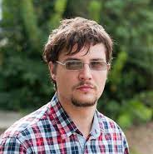
From individual actions to collective phenomena
Dr Marian-Andrei Rizoiu | Behavioral Data Science Lead
Marian-Andrei.Rizoiu@uts.edu.au https://www.behavioral-ds.science

Slide 2
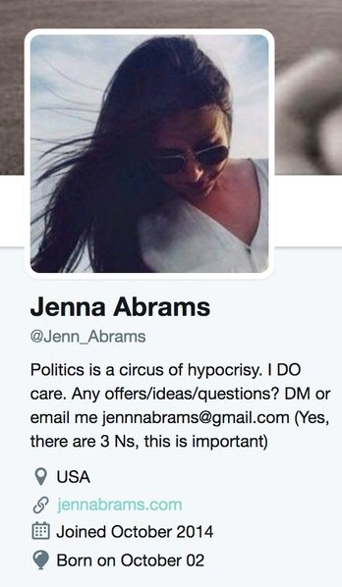

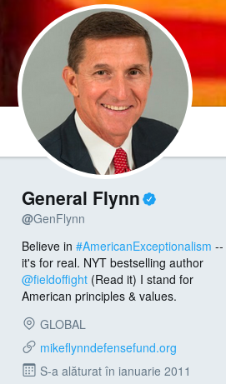
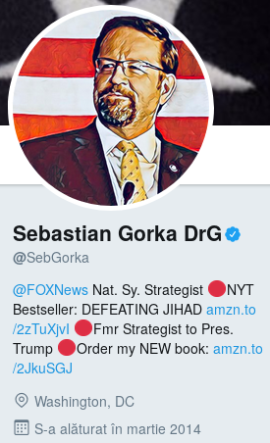
Who are our digital opinion leaders?
Common traits:
Highly influential;
Highly followed and retweeted;
Opinion leaders;
...
Russian-controlled trolls operated by the Internet Research Agency in St. Petersburg
60k followers
136k followers
[Forbes, The Guardian, CNN + 50 more]

Slide 3


Three rules of bird flocking behaviour
… can be explained by three individual level rules:
1. Separation
2. Alignment
3. Cohesion
Complex bird flock dynamics...

Slide 4
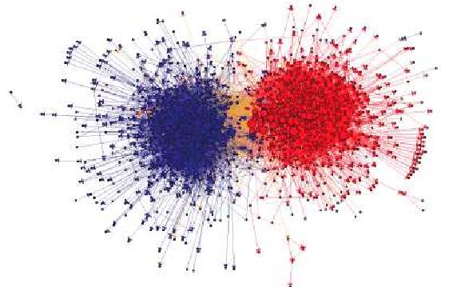

Our individual online actions shape online phenomena
Opinion polarisation
… are shaped by the individual-level decisions that people make:
Opinion manipulation Digital propaganda
What we reshare
How we find our peers
How we consume information
What shapes our values
Popularity, virality, attention
Complex societal phenomena ...

Slide 5
What if…
… we could understand and model individual level actions?
… we could predict the societal level effects?
… we can map in realtime information flow at scale?
… we could quantify the effectiveness of our (counter)messaging campaigns before deployment?

Slide 6
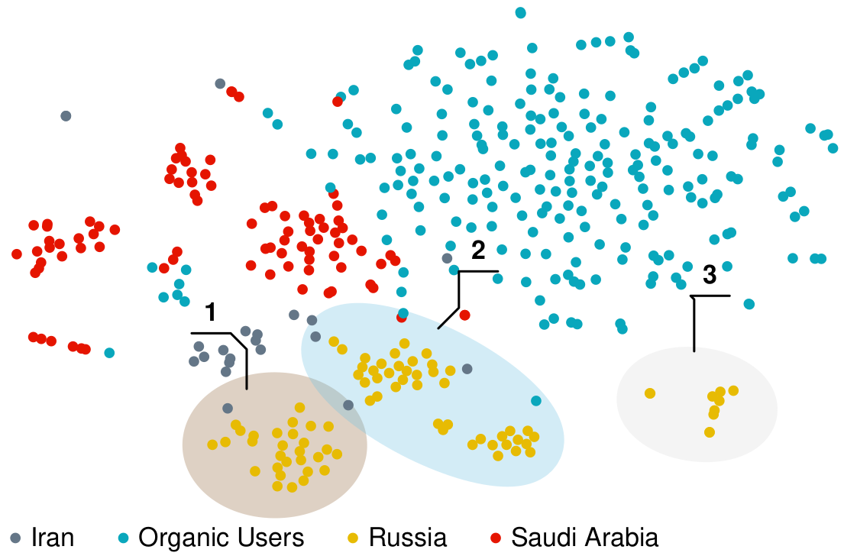
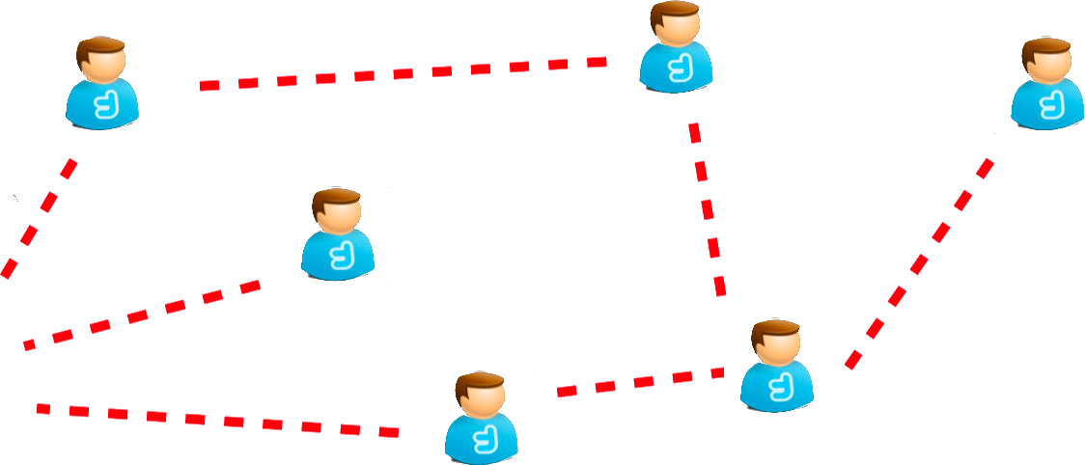


Today: Detect Information operation agents
We can use the reactions of social systems …
… to detect Information Operations agents and even individual troll farms.
The technical detail:
Users as social sensors; quantify users reaction to agents; Hawkes modelling; Transformer technology

Slide 7

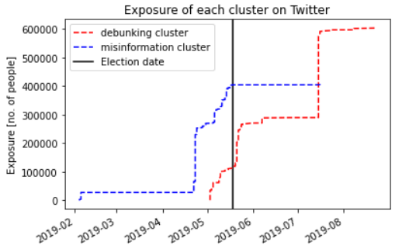
Today: Detect inauthentic coordinated campaigns
… can predict coordinated interventions
The structure of the information spread networks …
The technical detail:
Map information networks from social media; content, interactions, structure and diffusions analyse; social network analysis

Slide 8
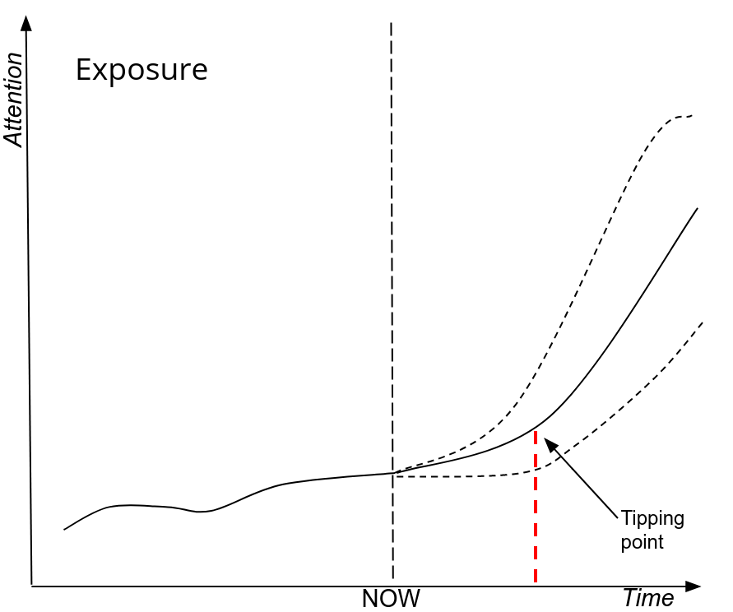
Soon: Predict the effectiveness of IO campaigns
Given an early observed spread, predict the future attention a narrative will gain
tipping points – the points at which the reach of IO increases exponentially
When to act? (hint: before tipping point)
What to counter? (hint: potentially popular IO)

Slide 9
Soon: Predict the “path” of an information spread

Slide 10



Research plan in Information and Influence
Thank you!
Monitor
Detect
Predict
Mitigate
Response level
What factors accelerate and intensify the communication and reach of weaponized messages within and across online environments, and which factors lead to the most significant real-world harms?
What are practical approaches that allow us to both pro-actively and re-actively limit the harms of problematic messaging, including identifying where, when and how counter-messaging should be deployed?
How can we develop and deploy dashboards to monitor discussion on both the social media and traditional media outlets, in which the adversaries are most likely to deploy the influence operations?
How do we most effectively identify and triage information campaigns based on the characteristics of the message, how it spreads, who is communicating it, and where it is being communicated?
Objective
Monitor discussions on social and traditional media
Detect adversarial information campaigns
Estimate the effectiveness of influence operations
Design and apply countermeasures
Characterising the dynamic interaction between traditional and social media ecosystems in the flow and spread of disinformation and problematic content.
Utilise information diffusion techniques to identify problematic content based on the way it moves through and across online channels
Model the impact of networks and influencers on the virality and reach of problematic messages
Use natural language processing to automatically generate counter-messaging that is tuned for the platform and target group of interest
Approach
Develop and deploy a "mission control" dashboard to retrieve content from a
constantly updating list of traditional media and Internet sources.
Deploy natural language processing techniques to automate the detection of problematic online messages based on the structure and content of the message
Track the spread of problematic messages across and between online platforms and into the real-world
Identify key message inoculation points in social networks based on how information flows and gains velocity

Slide 11


01101010010
01101011010
01101001000
01101011010
1010110
Other capabilities & expertise

Slide 12


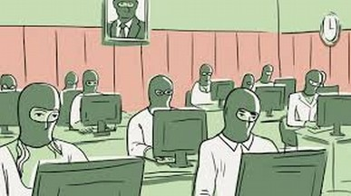

The Behavioral Data Science
1.
information diffusion epidemics spreading behavioral modeling
3.
2.
[Rizoiu et al ICWSM’18]
[Kim et al Journ.Comp.SocSci’19]

Slide 13

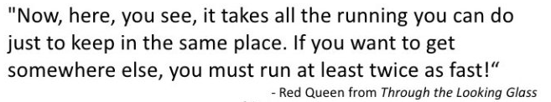
More challenges: Red Queen effect and generative models
Content- and user-based detection tools:
language nuances, language drift, foreign language-dependent
sensitive to adversarial training attacks – use the detector to train the attacker.
ChatGPT-like introduced problems:
Increase scalability of troll presence – # accounts manned by a single operator increase multifold
Increased awareness of social context knowledge, adapted to local language patterns
Adaptability for detection – generative models can spit out infinite variations of the same message.

Slide 14
Solution: not what they say, but what they stir
IO are designed to elicit particular reactions from the target audience
→ use these reactions to detect
→ cannot be faked or hidden, as they are the purpose of the campaign
Distinguish users and content types based on on the reaction of online social systems (no content)
Build early detection systems based on information spread patterns within the user population
Language invariant – the model doesn’t need to “speak” the language

Slide 15











Our founders (and friends) in the mis-, dis-, IO and IW spaces
Expert roundtable for Defamation law reform
Tracking Disinformation Campaigns across terrain
Information integrity initiative: fighting misinformation in Australia
Effectiveness of Information Operations in the Solomon Islands and Melanesia
Modelling in the Gray Zone: Complex Warfare “Real-time detection of disinformation campaigns”
Detection and debunking for online misinformation
Information Warfare STaR Shot “NARRATE: Developing Situational Awareness”
Improving Wikimedia resilience against the risks of content-generating AI systems
Hate Speech propagation on Social Media
Detecting and quantifying privacy loss over time

Slide 16
Behavioral DS action plan in Influence Operations space
Monitor
Detect
Predict
Mitigate
Response level
What factors accelerate and intensify the communication and reach of weaponized messages within and across online environments, and which factors lead to the most significant real-world harms?
What are practical approaches that allow us to both pro-actively and re-actively limit the harms of problematic messaging, including identifying where, when and how counter-messaging should be deployed?
How can we develop and deploy dashboards to monitor discussion on both the social media and traditional media outlets, in which the adversaries are most likely to deploy the influence operations?
How do we most effectively identify and triage information campaigns based on the characteristics of the message, how it spreads, who is communicating it, and where it is being communicated?
Objective
Monitor discussions on social and traditional media
Detect adversarial information campaigns
Estimate the effectiveness of influence operations
Design and apply countermeasures
Characterising the dynamic interaction between traditional and social media ecosystems in the flow and spread of disinformation and problematic content.
Utilise information diffusion techniques to identify problematic content based on the way it moves through and across online channels
Model the impact of networks and influencers on the virality and reach of problematic messages
Use natural language processing to automatically generate counter-messaging that is tuned for the platform and target group of interest
Approach
Develop and deploy a "mission control" dashboard to retrieve content from a
constantly updating list of traditional media and Internet sources.
Deploy natural language processing techniques to automate the detection of problematic online messages based on the structure and content of the message
Track the spread of problematic messages across and between online platforms and into the real-world
Identify key message inoculation points in social networks based on how information flows and gains velocity

Slide 17
Action plan
Monitor
Detect
Predict
Mitigate
Response level
What factors accelerate and intensify the communication and reach of weaponized messages within and across online environments, and which factors lead to the most significant real-world harms?
What are practical approaches that allow us to both pro-actively and re-actively limit the harms of problematic messaging, including identifying where, when and how counter-messaging should be deployed?
How can we develop and deploy dashboards to monitor discussion on both the social media and traditional media outlets, in which the adversaries are most likely to deploy the influence operations?
How do we most effectively identify and triage information campaigns based on the characteristics of the message, how it spreads, who is communicating it, and where it is being communicated?
Objective
Monitor discussions on social and traditional media
Detect adversarial information campaigns
Estimate the effectiveness of influence operations
Design and apply countermeasures
Characterising the dynamic interaction between traditional and social media ecosystems in the flow and spread of disinformation and problematic content.
Utilise information diffusion techniques to identify problematic content based on the way it moves through and across online channels
Model the impact of networks and influencers on the virality and reach of problematic messages
Use natural language processing to automatically generate counter-messaging that is tuned for the platform and target group of interest
Approach
Develop and deploy a "mission control" dashboard to retrieve content from a
constantly updating list of traditional media and Internet sources.
Deploy natural language processing techniques to automate the detection of problematic online messages based on the structure and content of the message
Track the spread of problematic messages across and between online platforms and into the real-world
Identify key message inoculation points in social networks based on how information flows and gains velocity

Slide 18
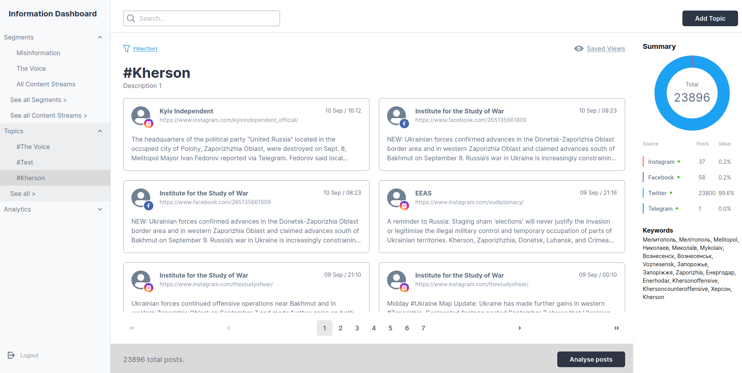

Monitor: Monitoring discussion spaces

Slide 19
Action plan
Monitor
Detect
Predict
Mitigate
Response level
What factors accelerate and intensify the communication and reach of weaponized messages within and across online environments, and which factors lead to the most significant real-world harms?
What are practical approaches that allow us to both pro-actively and re-actively limit the harms of problematic messaging, including identifying where, when and how counter-messaging should be deployed?
How can we develop and deploy dashboards to monitor discussion on both the social media and traditional media outlets, in which the adversaries are most likely to deploy the influence operations?
How do we most effectively identify and triage information campaigns based on the characteristics of the message, how it spreads, who is communicating it, and where it is being communicated?
Objective
Monitor discussions on social and traditional media
Detect adversarial information campaigns
Estimate the effectiveness of influence operations
Design and apply countermeasures
Characterising the dynamic interaction between traditional and social media ecosystems in the flow and spread of disinformation and problematic content.
Utilise information diffusion techniques to identify problematic content based on the way it moves through and across online channels
Model the impact of networks and influencers on the virality and reach of problematic messages
Use natural language processing to automatically generate counter-messaging that is tuned for the platform and target group of interest
Approach
Develop and deploy a "mission control" dashboard to retrieve content from a
constantly updating list of traditional media and Internet sources.
Deploy natural language processing techniques to automate the detection of problematic online messages based on the structure and content of the message
Track the spread of problematic messages across and between online platforms and into the real-world
Identify key message inoculation points in social networks based on how information flows and gains velocity

Slide 20
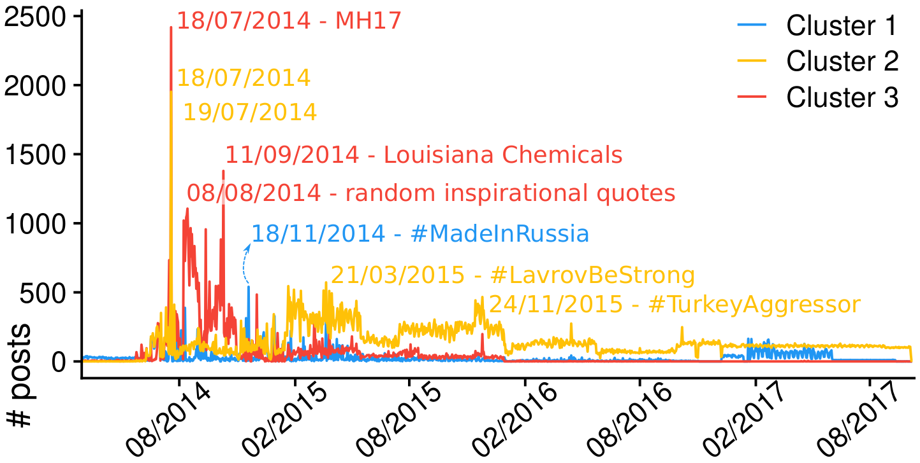
Detect: identify agent types and coordinated behavior
IC-TH clusters IO agents from specific countries based solely on the timing of the cascades in which they participate; it identifies even individual “troll farms”.
Qualitative investigations uncovers strategies of Russian trolls farms: C1: Russian news with patriotic framing; C2: Regional and conservative news; C3: tweet in English, #music, #usa, relationship advice
The technical detail:
Interval-censored Transformer Hawkes; Twitter Moderation Research Consortium dataset; partial data loss
Kong, Q., Calderon, P., Ram, R., Boichak, O., & Rizoiu, M.-A. (2023). Interval-censored Transformer Hawkes: Detecting Information Operations using the Reaction of Social Systems. In ACM Web Conference (WWW’23) (pp. 1–9). https://doi.org/10.1145/3543507.3583481

Slide 21
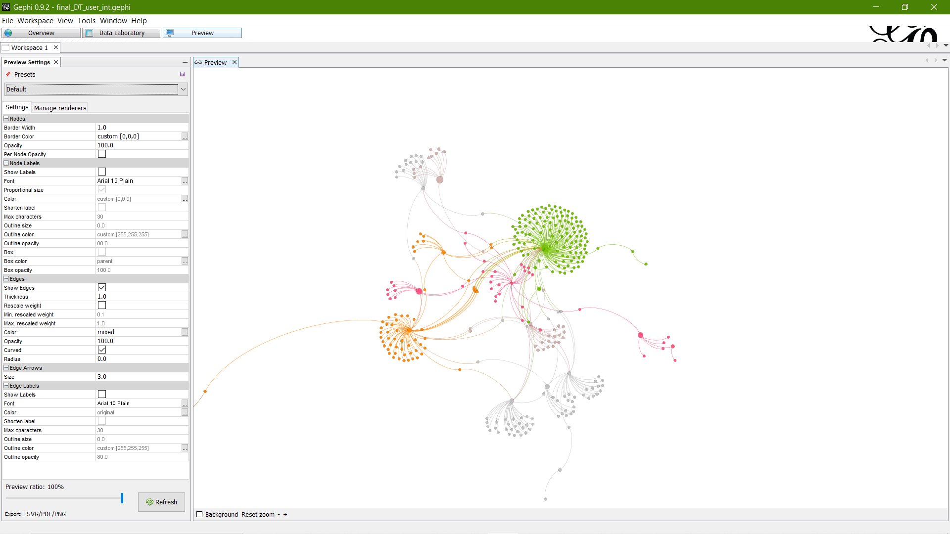
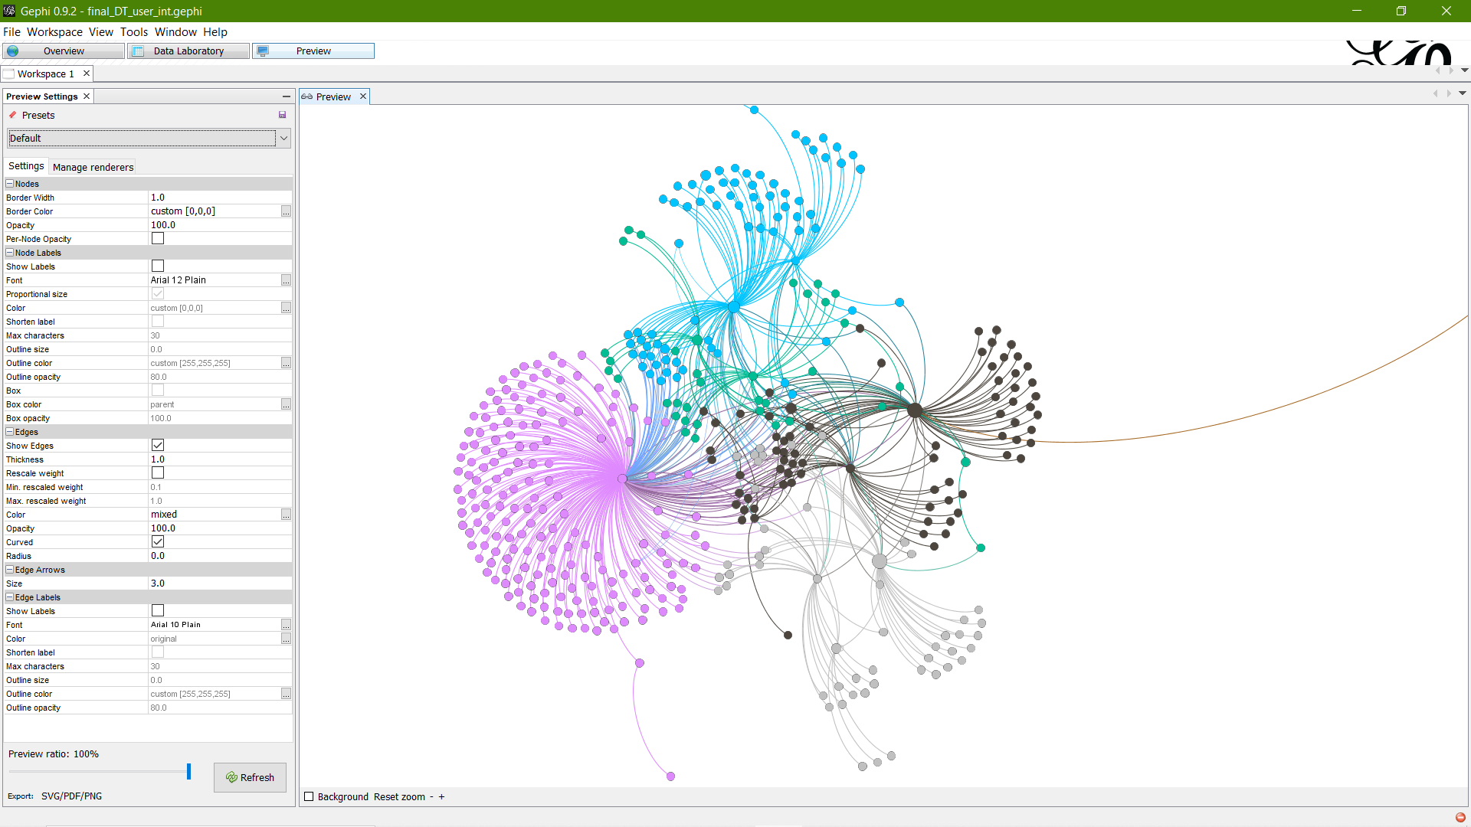
Detect: two clusters emerge
Feeney4Batman
labor_trash
suspended
AaronDodd
HelpRodger
inactive
PutLaborLast
inactive
AllNewsAlliance
broomstick33
CatPurry9
ExSydney
Observations:
Two clusters – one misinformation and one debunking the misinformation
Misinformation cluster (right) is strongly connected compared to debunking cluster (left), cross resharing
Notes:
5

Slide 22
Detect: Detect Russian IO operatives and their narratives in Ukraine
Collect data on Telegram and Twitter, in three languages (Russian, Ukrainian and English)
Kherson counteroffensive (29/08/2022- 11/11/2022):
#Kherson / # Херсон
#Khersoncounteroffensive
#Khersonoffensive
#Enerhodar / #Енергодар
#Zaporizhia / #Запоріжжя / #Запорожье
#Voznesensk / #Вознесенськ / #Вознесенск
#Mykolaiv / #Миколаїв / #Николаев
#Melitopol / #Мелітополь / #Мелитополь
Kharkiv counteroffensive (06/09/2022-02/10/2022):
#Kharkiv / #Харків / #Харьков
#Izium / #Ізюм / #Изюм
#Balakliia / #Балаклія / #Балаклия
#Kupiansk / #Купянськ / #Купянск
#Sviatohirsk / #Святогірськ / #Святогорск
#Svatove / #Сватове
#Kreminna / #Кремінна / #Кременная
#Luhansk / #Луганськ / #Луганск
#Schevchenkove / #Шевченкове
#Verbivka / #Вербівка
#Yakovenkove / #Яковенкове

Slide 23
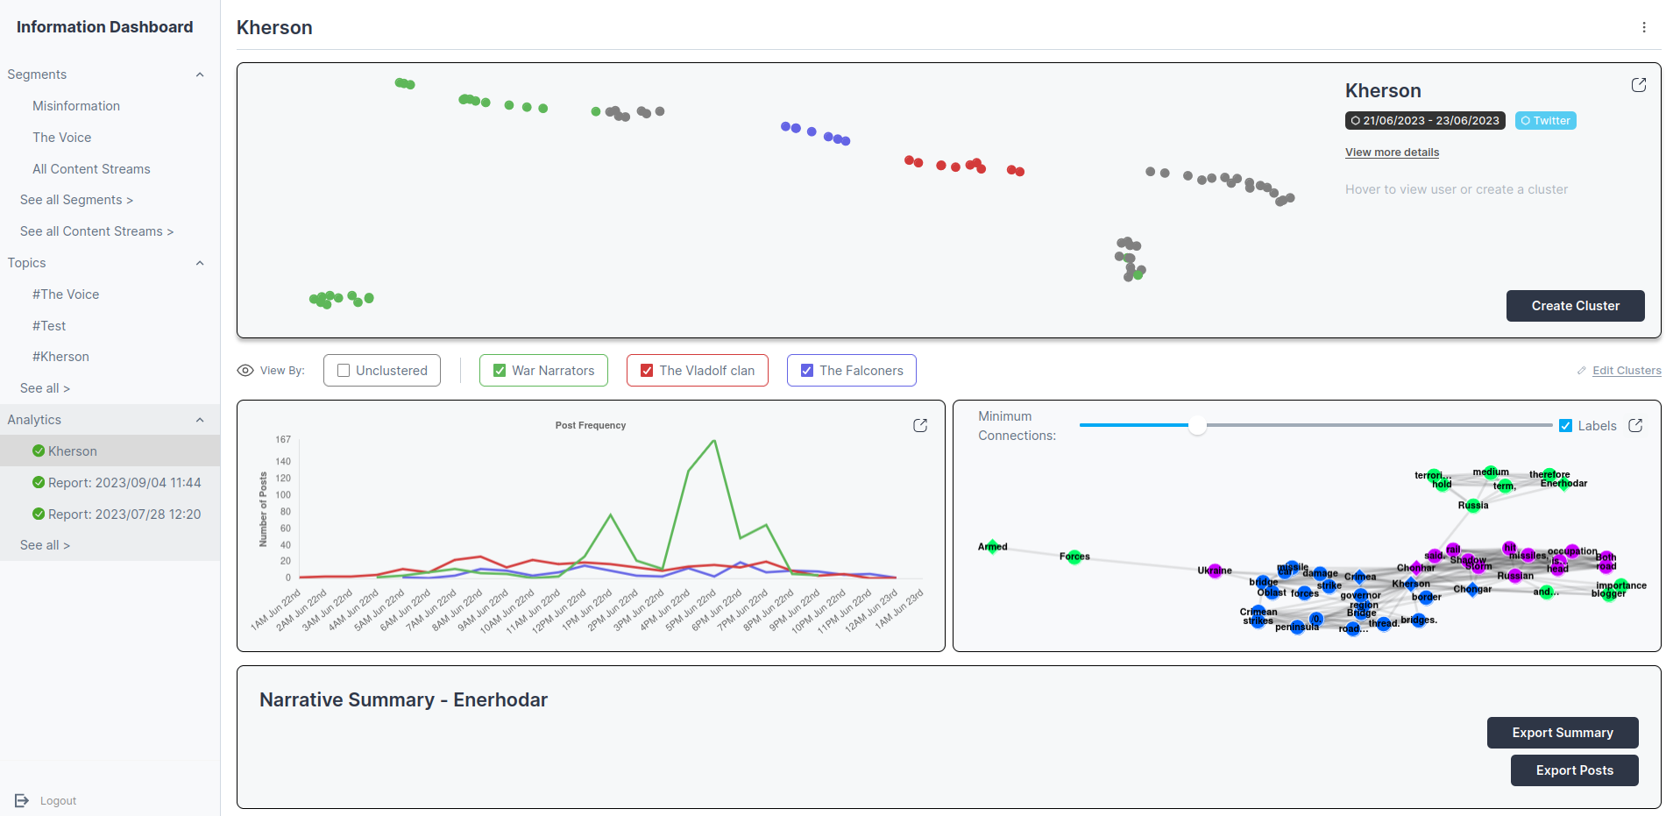
Detect: Detect Russian IO operatives and their narratives in Ukraine

Slide 24
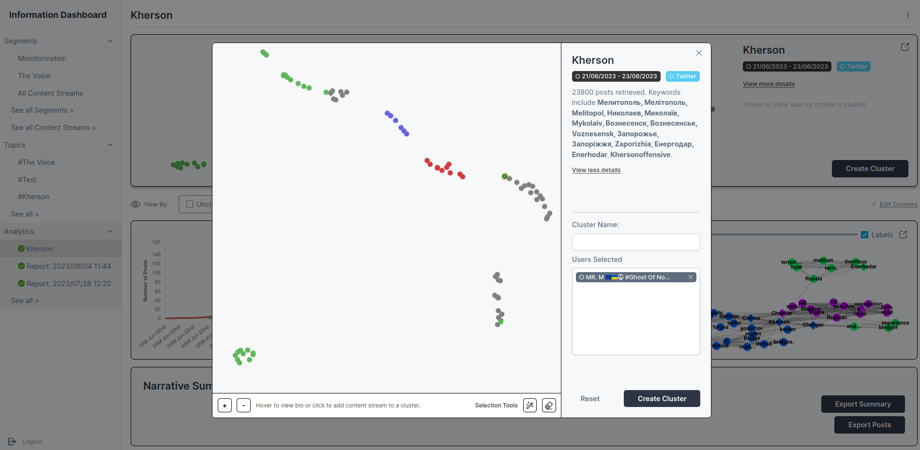
Detect: Detect Russian IO operatives and their narratives in Ukraine

Slide 25
Action plan
Monitor
Detect
Predict
Mitigate
Response level
What factors accelerate and intensify the communication and reach of weaponized messages within and across online environments, and which factors lead to the most significant real-world harms?
What are practical approaches that allow us to both pro-actively and re-actively limit the harms of problematic messaging, including identifying where, when and how counter-messaging should be deployed?
How can we develop and deploy dashboards to monitor discussion on both the social media and traditional media outlets, in which the adversaries are most likely to deploy the influence operations?
How do we most effectively identify and triage information campaigns based on the characteristics of the message, how it spreads, who is communicating it, and where it is being communicated?
Objective
Monitor discussions on social and traditional media
Detect adversarial information campaigns
Estimate the effectiveness of influence operations
Design and apply countermeasures
Characterising the dynamic interaction between traditional and social media ecosystems in the flow and spread of disinformation and problematic content.
Utilise information diffusion techniques to identify problematic content based on the way it moves through and across online channels
Model the impact of networks and influencers on the virality and reach of problematic messages
Use natural language processing to automatically generate counter-messaging that is tuned for the platform and target group of interest
Approach
Develop and deploy a "mission control" dashboard to retrieve content from a
constantly updating list of traditional media and Internet sources.
Deploy natural language processing techniques to automate the detection of problematic online messages based on the structure and content of the message
Track the spread of problematic messages across and between online platforms and into the real-world
Identify key message inoculation points in social networks based on how information flows and gains velocity

Slide 26
Predict: Effectiveness of state-sponsored narratives
Purpose: Predicting the Effectiveness of State-sponsored Influence Operations: a Case Study of the Solomon Islands and Melanesia
Questions:
RQ1: Do Chinese IO operations in different regions of Melanesia consistently use particular narrative constructions and language? Do they seek to elicit specific reactions?
RQ2: How to effectively identify and triage information campaigns based on the characteristics of the message, how it spreads, who is communicating it, and where it is being communicated?
RQ3: What factors accelerate the reach of weaponized messages within and across online environments, and which factors lead to the most significant real-world harm?
RQ4: How to forecast the future attention received by an IO? How to distinguish those IO likely to be effective? Is there a tipping point before which countermeasures are most effective?

Slide 27
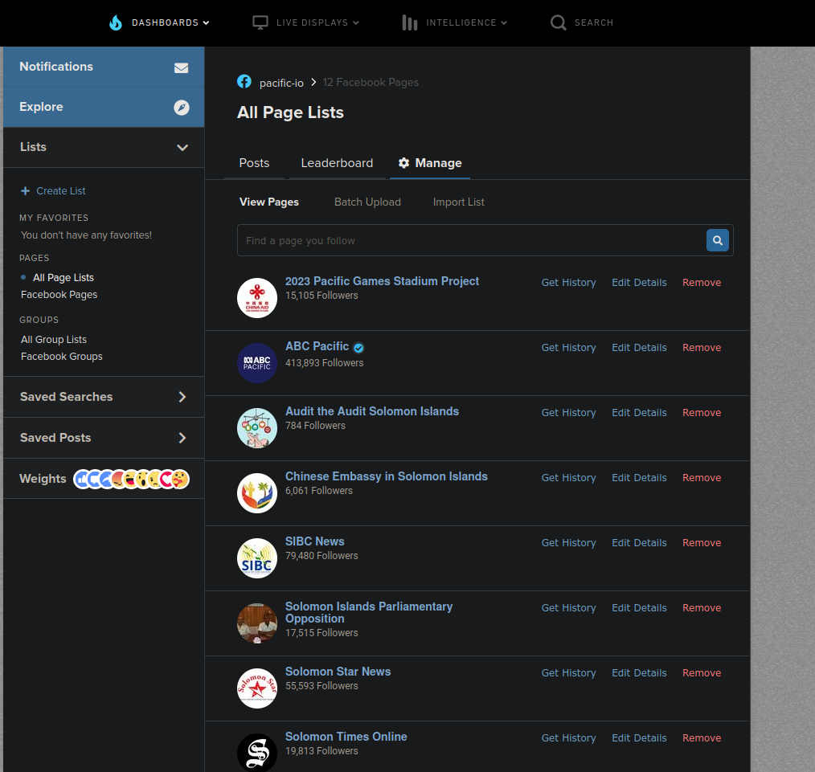
Predict: Melanesia IO – on-the-ground & protocol
Qualitative protocol:
Compile a list of significant past events and study who pushed what
Identify where the discussions take place
Who are the actors (vectors) pushing narratives?
What are the main themes and topics?
Two Research Assistants on the ground:
Places: Solomon Islands, Vanuatu
Tasks: Identify where are the discussions taken — on Facebook
Safety protocol: they have limited knowledge of the aims of this project (i.e. China’s IO).
Collecting Facebook data from identified vectors using CrowdTangle

Slide 28
Predict: Melanesia IO findings – Events and narratives
Five historical events in Solomons:
Honiara Riots and burning of Chinatown
Switch of public recognition from Taiwan to China
Signing of the PRC-SI Security Pact
Australia Offers to Fund Solomon Islands Elections
U.S. embassy opening in Honiara

Slide 29
Predict: Melanesia IO findings – Events and narratives
(some) Identified narratives:
Solomon Islands should become economically self-reliant and vibrant post-RAMSI, through relations with China.
The West excludes China from the South Pacific to perpetuate their domination.
Australia and the US are colonialist bullies that threaten Solomon Islands sovereignty.
The West perpetuate a ‘Cold War mentality’.
Westernised activists and civil society groups undermine the Solomon Islands government.
Australia is trying to interfere in Solomon Islands democracy.
The West instigated the November 2021 Honiara riots.
Australia and the West will invade the Solomons because of its security relations with China.
RAMSI: Regional Assistance Mission to Solomon Islands (RAMSI) led by Australia and New Zealand.

Slide 30
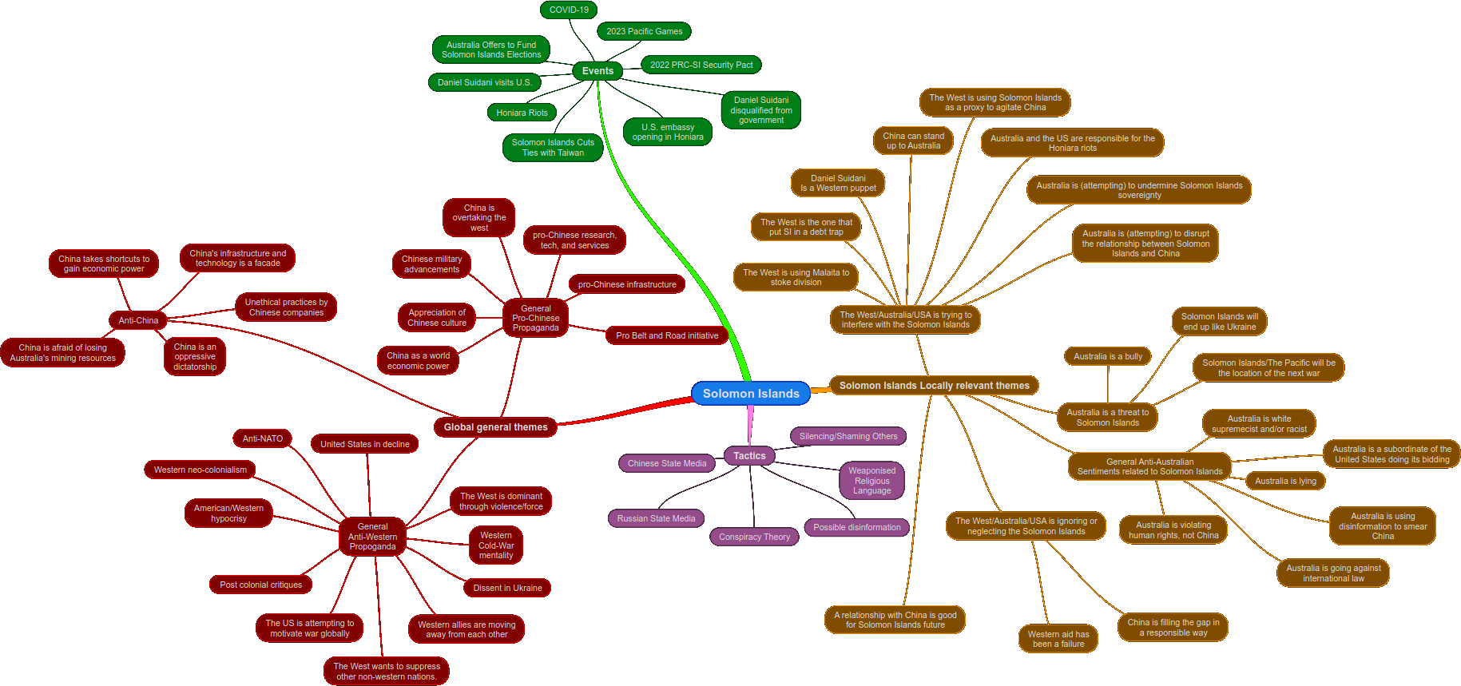
Predict: Solomon Islands findings – Events and narratives
(zoomable version here)

Slide 31
Predict: Melanesia IO findings – Network for fake accounts affiliated with China
The implantation of narratives and false information is not in the stories, but in the comments
Most of these comments are from a (small) set of key individuals
We suspect that a number of this accounts are fake accounts – e.g., portraying to be honiarans when in fact they don’t live in the Solomons
The news articles do not really contain misinformation, only propaganda; some comments make fake claims
We find that pro-chineese stories do not get a lot of engagement; local stories about Solomon’s get engagement
We find significant positivity about Australia in the people’s comments
Surveys show that ~80% of the elites in the Melanesia trust Australia – where would you go for medical treatment or education?

Slide 32
Predict: Melanesia IO findings – China exerts influence via trolling and policing on key issues
Hypothesis: China exerts influence via trolling and policing on key issues.
when anti-China comments come in, the network of fake accounts barge in; usually using shaming
usually the initial commenter fades back into the background
Repetition is key – repeat the same messages (even if no engagement) and police disident opinions

Slide 33
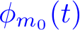

Predict: Model effectiveness Self-exciting (Hawkes) processes
[Hawkes, 1971]
t
Event intensity
base intensity
(exogenous)
self-excitation
(endogenous)

Slide 34
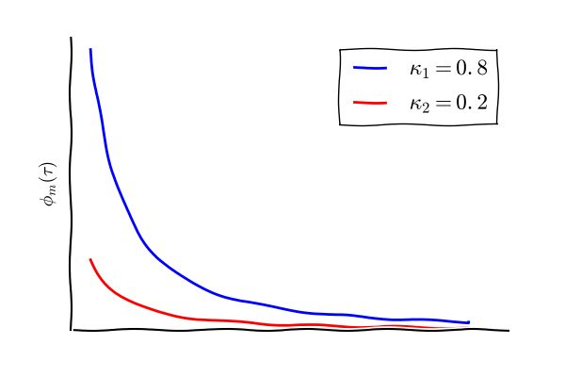
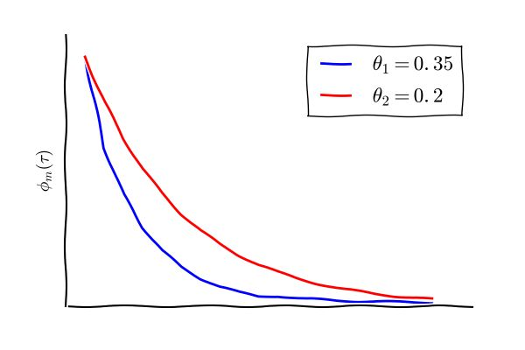
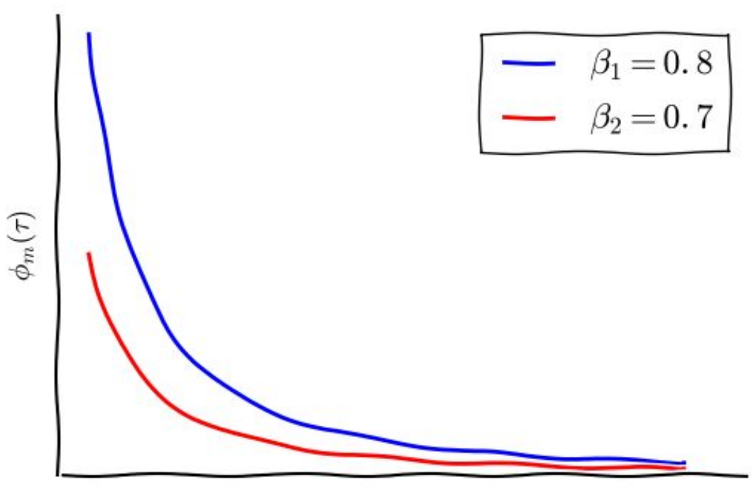
Predict: The “social media” kernel
the rate of ‘daughter’ events
content virality
memory
user influence
S. Mishra, M.-A. Rizoiu, and L. Xie, "Feature Driven and Point Process Approaches for Popularity Prediction, " in Proc. International Conference on Information and Knowledge Management (CIKM ’16), Indianapolis, USA, p. 1069-1078, 2016.

Slide 35
Predict: Future adoption and tipping points
Given an early observed spread, predict the future attention a narrative will gain
tipping points – the points at which the reach of IO increases exponentially
When to act? (hint: before tipping point)
What to counter? (hint: potentially popular IO)

Slide 36
Predict: social neighborhoods on the “path” of a spread

Slide 37
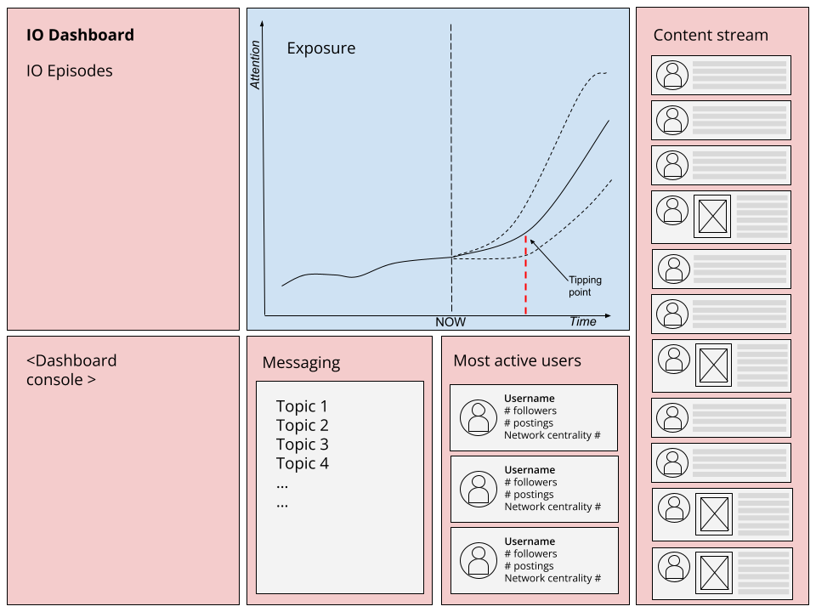
Predict: Effectiveness of state-sponsored narratives

Slide 38
Action plan
Monitor
Detect
Predict
Mitigate
Response level
What factors accelerate and intensify the communication and reach of weaponized messages within and across online environments, and which factors lead to the most significant real-world harms?
What are practical approaches that allow us to both pro-actively and re-actively limit the harms of problematic messaging, including identifying where, when and how counter-messaging should be deployed?
How can we develop and deploy dashboards to monitor discussion on both the social media and traditional media outlets, in which the adversaries are most likely to deploy the influence operations?
How do we most effectively identify and triage information campaigns based on the characteristics of the message, how it spreads, who is communicating it, and where it is being communicated?
Objective
Monitor discussions on social and traditional media
Detect adversarial information campaigns
Estimate the effectiveness of influence operations
Design and apply countermeasures
Characterising the dynamic interaction between traditional and social media ecosystems in the flow and spread of disinformation and problematic content.
Utilise information diffusion techniques to identify problematic content based on the way it moves through and across online channels
Model the impact of networks and influencers on the virality and reach of problematic messages
Use natural language processing to automatically generate counter-messaging that is tuned for the platform and target group of interest
Approach
Develop and deploy a "mission control" dashboard to retrieve content from a
constantly updating list of traditional media and Internet sources.
Deploy natural language processing techniques to automate the detection of problematic online messages based on the structure and content of the message
Track the spread of problematic messages across and between online platforms and into the real-world
Identify key message inoculation points in social networks based on how information flows and gains velocity

Slide 39
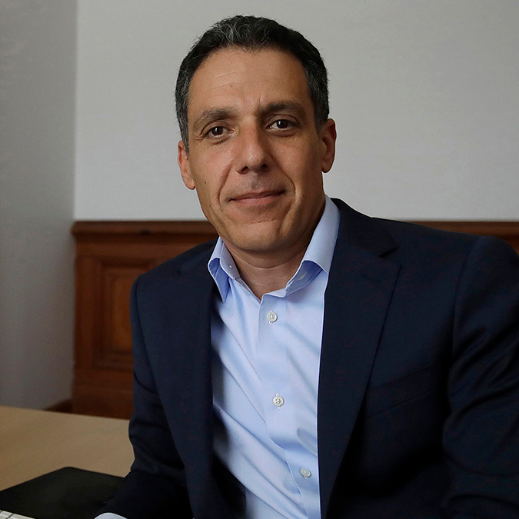
Mitigate: countering conspiracy theories, misinformation and state-sponsored IO
Questions:
RQ1: Are messages written in particular styles more effective in spreading?
RQ2: Do different audiences/segments of the population prefer specific styles?
RQ3: Can we use Generative Language models (ChatGPT-like) to construct effective interventions “in the style of…”
RQ4: Can we test the interventions in simulated environment before deploying them?
Prof Hany Farid UC Berkeley

Slide 40
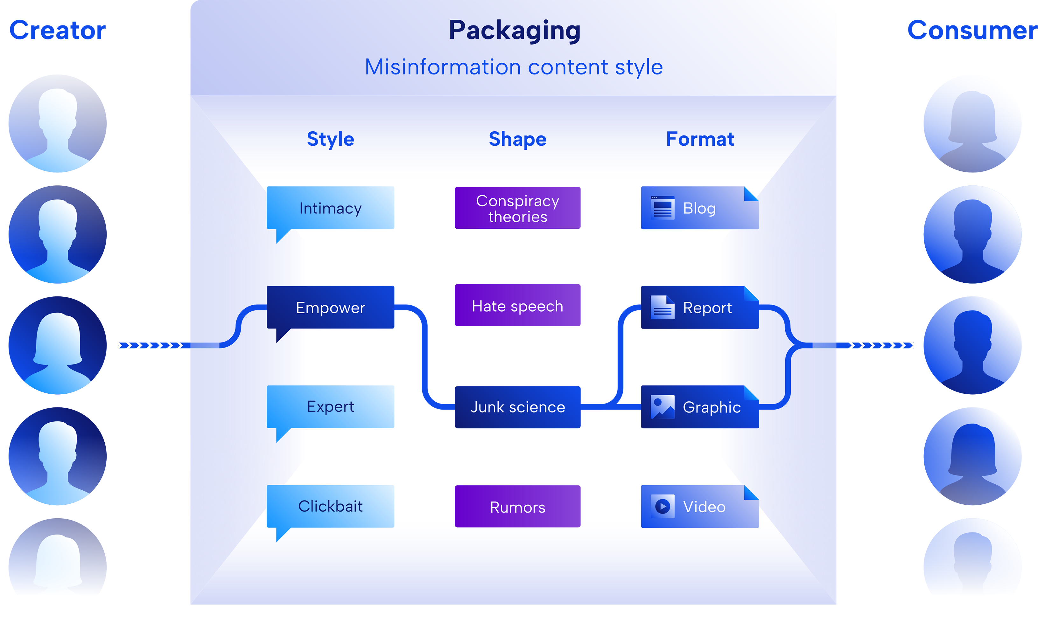
Mitigate: misinformation as a content consumption problem
1
Aim: understand how misinformation spreads in Australia’s online ecosystem.
Findings:
Misinformation is an online product targeting specific vulnerable populations.
People believe and share misinformation that aligns with their preexisting beliefs and communication style.
Tailored messaging is 50-100% more effective than generic communication.
Identify vulnerable users based on their communication style rather than content.

Slide 41
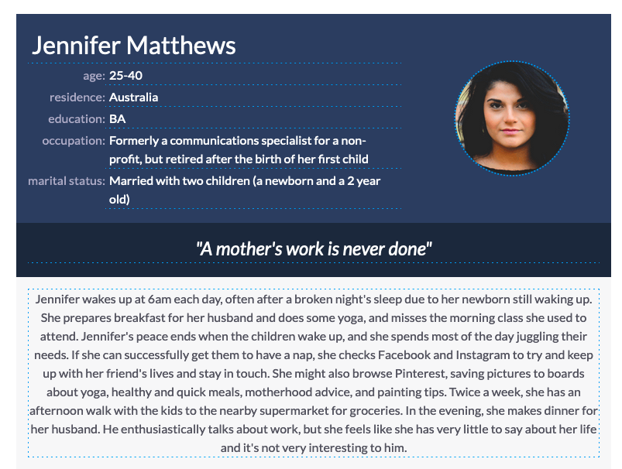
Vulnerable target personae – Jennifer
Interests:
Health, children, creativity, simple pleasures
Fears
Her children will get sick
She is not the best mother she could be
Her friends at work forget her
She become unattractive to her husband after having two children
Preferred style:
Intimacy + Junk Science
Barrier to generic communication: formal, masculine style

Slide 42
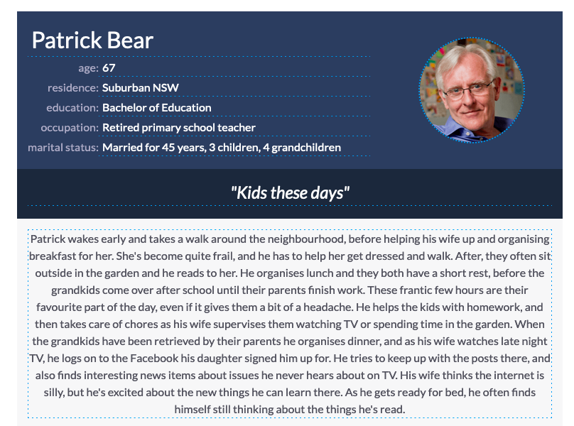
Vulnerable target personae – Patrick
Interests:
Humour, Hard work, Family
Fears
New changes in the world
His family forgetting him
Financial security
Being alone
Illness and death for him and his wife
Preferred style:
Expert + Conspiracy
Barrier to generic communication: belief in own expertise, difficulty in understanding long complex text

Slide 43
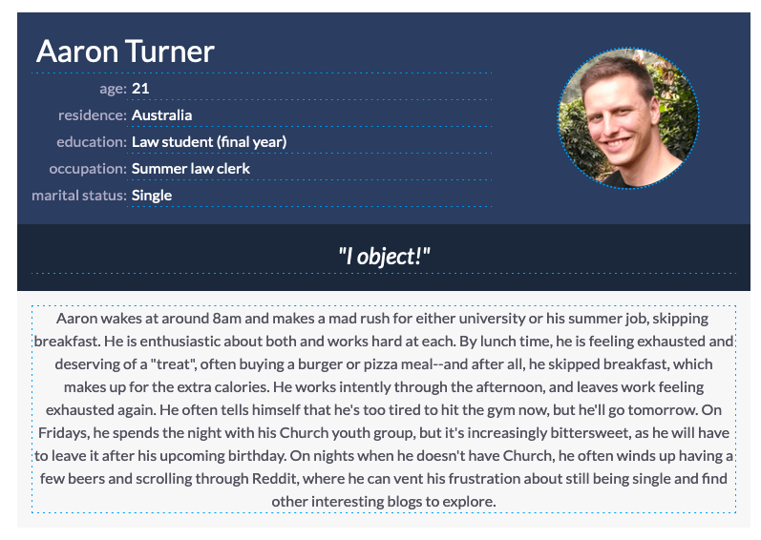
Vulnerable target personae – Aaron
Interests:
Strength and confidence in men
Beauty in women
Christianity
Recognition for his hard work
Fears
Professional failure
Personal failure – He will not get a girlfriend
He will lose his connection to his Church
Preferred style:
Empower + Hate Speech
Barrier to generic communication: authoritative tone

Slide 44
Mitigate: run “packaged” ads campaigns
Instruction set:
Write a 100 word social media post that would appeal to Jennifer, accounting for:
the post comes from a fellow mother who understands Jennifer's fears
she reassures her that vaccines are safe for her children.
she vaccinated her children against smallpox the other day, and 2 weeks later all the children in the neighborhood got it, except hers.
write it as if it is send on a mum's Facebook group.
A synthetically-generated social media post , campaigning for vaccines targeting the “Jennifer” persona.

Slide 45
Mitigate: run “packaged” ads campaigns
Generated post:
Hey mamas,
I just wanted to share something with you all that happened recently. I vaccinated my kids against smallpox a couple of weeks ago and, unfortunately, all the kids in our neighborhood got it except mine. It's a scary thing when there's a new vaccine out there, but I just wanted to let you all know that vaccines are safe and effective. They've been tested a ton, and they work to protect our kids from some really dangerous diseases. So if you're still on the fence about vaccinating your kiddos, I'm here to tell you - do it!
Let's keep our babies healthy and safe together!
#MomSquad #VaccineSafety #SmallpoxPrevention #HealthyKids.
Love,
One of your fellow moms.
A synthetically-generated social media post , campaigning for vaccines targeting the “Jennifer” persona.

Slide 46
Testing protocol:
Tested variables:
Success measurement
Mitigate: Effectiveness of communication styling
Facebook ads with A/B testing facility
Stock images
Ads link to Government information sites
A/B test: targeted (A) vs generic styling (B). All other indicators stay the same: target demographic, image, message
Three target demographics – consumer personae
Four message styling – generic, Jennifer-, Patrick- and Aaron-styled
5 topics of interest: children vaccination, children sexual education, 5G, climate change, nutrition supplements for physical fitness
Click-Through-Rate (CTR): number of clicks vs number of impressions
Higher (CTR) – higher message effectiveness

Slide 47


Children vaccination (Jennifer)
Mitigate: Effectiveness of communication styling
A: Generic
B: Styled
Results:
A: Generic
Reach: 10,346 users
Impressions: 15,567
Clicks: 101
CTR: 0.65%
B: Styled
Reach: 10,020 users
Impressions: 13,107
Clicks: 129
CTR: 0.98%
Improvement:
51%

Slide 48


Climate change (Patrick)
Mitigate: Effectiveness of communication styling
A. Generic
B. Styled
Results:
A: Generic
Reach: 5,362 users
Impressions: 10,095
Clicks: 170
CTR: 1.68%
B: Styled
Reach: 5,952 users
Impressions: 10,082
Clicks: 334
CTR: 3.31%
Improvement:
97%

Slide 49
Action plan in Countering Foreign interference and state backed IO
Monitor
Detect
Predict
Mitigate
Response level
What factors accelerate and intensify the communication and reach of weaponized messages within and across online environments, and which factors lead to the most significant real-world harms?
What are practical approaches that allow us to both pro-actively and re-actively limit the harms of problematic messaging, including identifying where, when and how counter-messaging should be deployed?
How can we develop and deploy dashboards to monitor discussion on both the social media and traditional media outlets, in which the adversaries are most likely to deploy the influence operations?
How do we most effectively identify and triage information campaigns based on the characteristics of the message, how it spreads, who is communicating it, and where it is being communicated?
Objective
Monitor discussions on social and traditional media
Detect adversarial information campaigns
Estimate the effectiveness of influence operations
Design and apply countermeasures
Characterising the dynamic interaction between traditional and social media ecosystems in the flow and spread of disinformation and problematic content.
Utilise information diffusion techniques to identify problematic content based on the way it moves through and across online channels
Model the impact of networks and influencers on the virality and reach of problematic messages
Use natural language processing to automatically generate counter-messaging that is tuned for the platform and target group of interest
Approach
Develop and deploy a "mission control" dashboard to retrieve content from a
constantly updating list of traditional media and Internet sources.
Deploy natural language processing techniques to automate the detection of problematic online messages based on the structure and content of the message
Track the spread of problematic messages across and between online platforms and into the real-world
Identify key message inoculation points in social networks based on how information flows and gains velocity

Slide 50











Monitor: Semi-automatic data labelling
Qualitative study
Social Media Platforms
Qualitative Researchers
Wikibase
Postings
Opinions
Topics
Data Collection Tools
Data to label
Data Sampler
Trained Classifiers
Unlabeled Data
Unlabeled data collection
Dataset augmentation
Kong, Q., Booth, E., Bailo, F., Johns, A., & Rizoiu, M.-A. (2022). Slipping to the Extreme: A Mixed Method to Explain How Extreme Opinions Infiltrate Online Discussions. In AAAI International Conference on Web and Social Media. Retrieved from http://arxiv.org/abs/2109.00302

Slide 51



Detect: far-right and extremist ideology detection
No data labelling required for new datasets
Seed users: use fringe news sharing to label a small subset of users
Text-based homophily quantification – “what you write is who you are”
Use advanced Machine Learning to label all users
The technical detail:
Ideology proxies; homophily lenses (text, follower, URLs); automatic user labelling
Ram, R., Thomas, E., Kernot, D., & Rizoiu, M.-A. (2022). Detecting Extreme Ideologies in Shifting Landscapes: an Automatic & Context-Agnostic Approach. Retrieved from http://arxiv.org/abs/2208.04097
Notes:
At a high-level, our pipeline has four components; We start from a dataset, which we conceptualise as a set of users; We employ an ideological proxy label some seed users;
We construct a lens to view the similarity between users and form ties; And finally, we propogage the seed labels through the ties, using a SOTA Tree-based classifier, LGBM.

Slide 52
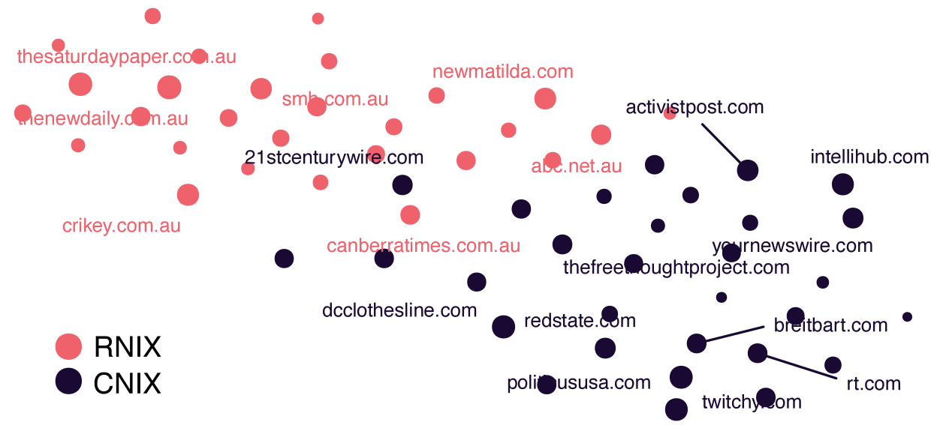

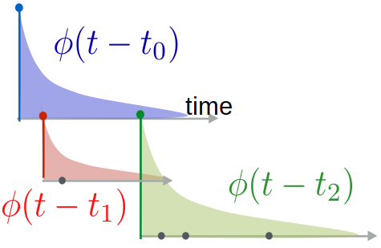
Detect: separating controversial from reputable
Reputable and controversial sources are separable based solely on how their information spreads
Detect controversial news without content analysis
News sources
Reputable
Controversial
The technical detail:
evently
Mathematical generative modelling; Hawkes processes; joint modelling
https://www.behavioral-ds.science/theme1_content/evently/
Kong, Q., Rizoiu, M. A., & Xie, L. (2020). Describing and Predicting Online Items with Reshare Cascades via Dual Mixture Self-exciting Processes. In International Conference on Information and Knowledge Management, Proceedings (pp. 645–654). New York, NY, USA: ACM. https://doi.org/10.1145/3340531.3411861

Slide 53
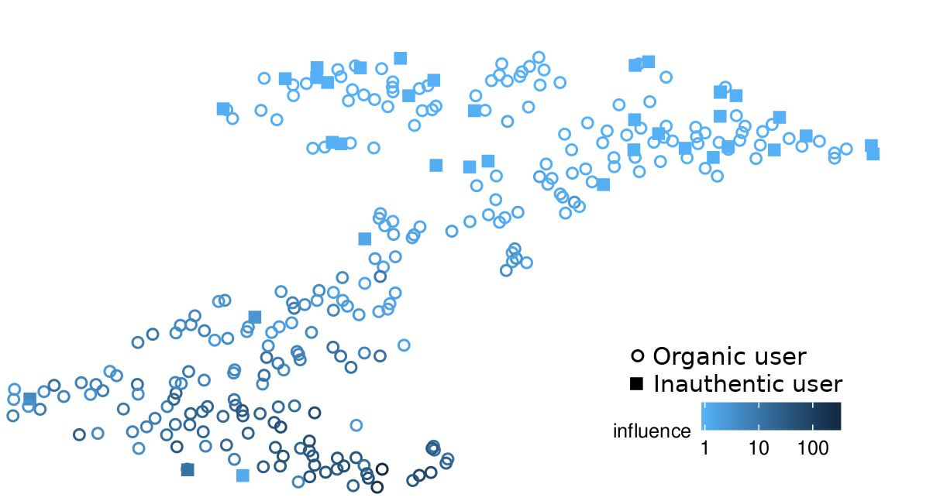


React: Identify influential inauthentic users (bots)
Identify users engaged in influence operations
Estimate their impact on the wider community
The technical detail:
birdspotter
Influence estimation using stochastic modelling; content-free analysis
https://www.behavioral-ds.science/theme2_content/birdspotter/
Ram, R., & Rizoiu, M.-A. (2021). Conductance and Social Capital: Modeling and Empirically Measuring Online Social Influence. Retrieved from http://arxiv.org/abs/2110.12569

Slide 54
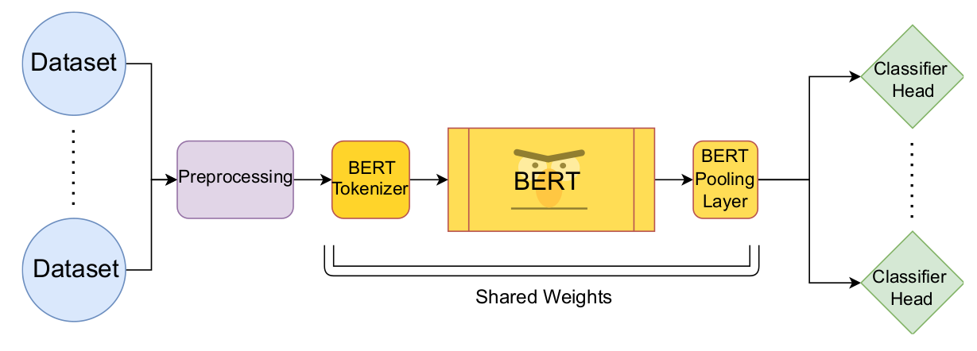
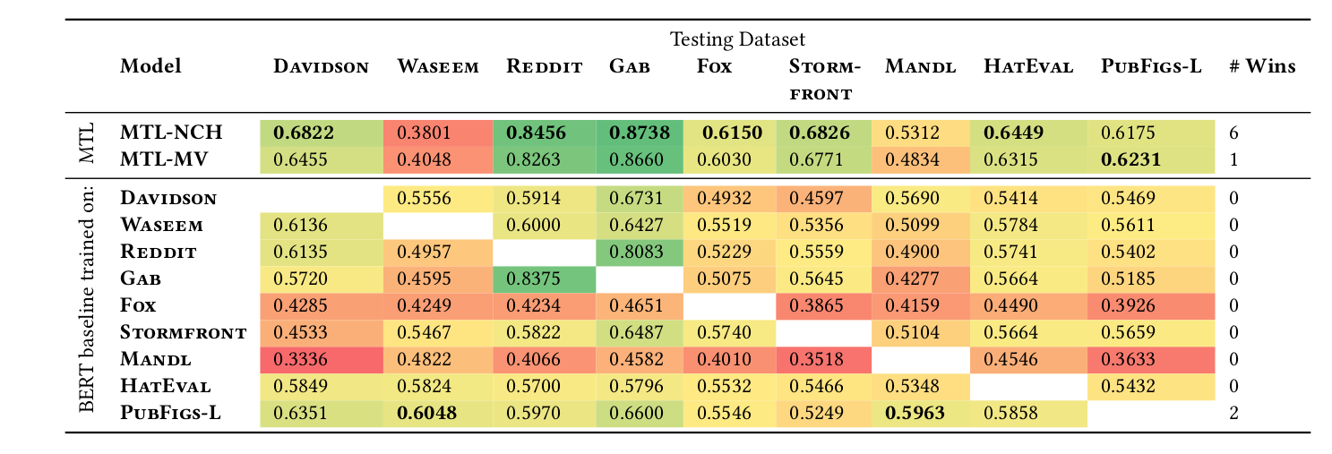
React: Detecting Hate Speech in Unseen Domains
Novel learning paradigm to leverage many disparate datasets to learn a single hate speech representation
Improved performances over the state-of-the-art, generalizable to novel datasets.
The technical detail:
Transfer learning; language models fine-tuning;
Yuan, L., & Rizoiu, M.-A. (2022). Detect Hate Speech in Unseen Domains using Multi-Task Learning: A Case Study of Political Public Figures. Retrieved from http://arxiv.org/abs/2208.10598

Slide 55
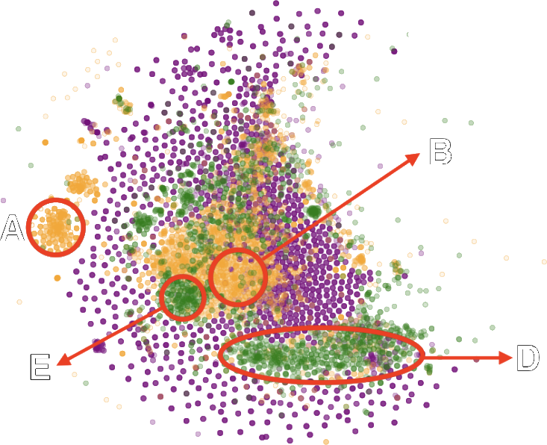
Analysing coordinated troll strategies
(yellow) right trolls: focused MAGA
(magenta) left trolls: surround discussion
(green) news trolls: selective highlighting
A – (right trolls) Hillary cannot be trusted #ThingsMoreTrustedThanHillary
B – (right trolls) Mimic black Trump supporters #Blacks4Trump
C – (news trolls) News about violence and civil unrest #news
D – (news trolls) Federal politics, policy and regulation #politics
B
A
C
D
The technical detail:
Semantic edit distance; dimensionality reduction; Twitter trolls

Slide 56
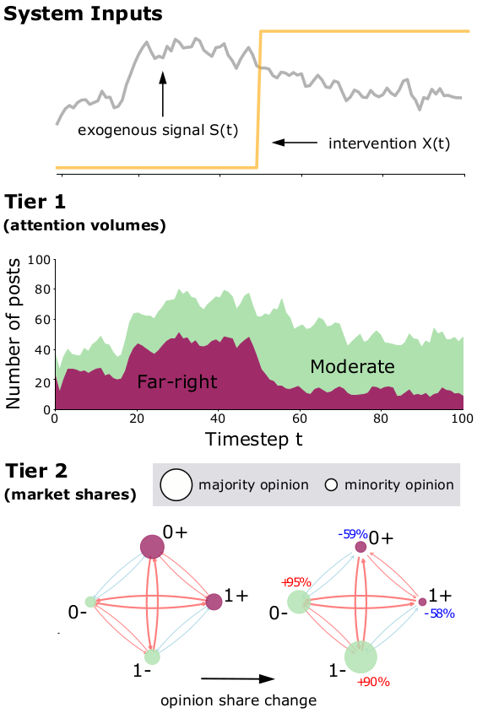
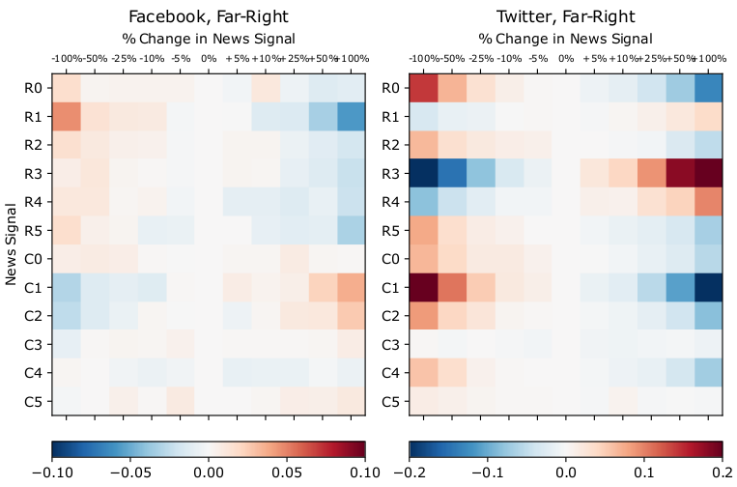
Mitigate: synthetic testing of interventions
Some interventions back-fire (R3), other work (R0)

